Slide 1
ITM7000 Master project
Dr. Qizhen Gu (Kimi)

Slide 2
Dr. Qizhen gu (kimi)
BBA-Major Marketing; Minor Management AU
MBA-AU; M.Sc.-TSM
Ph.D. Innovative Technology Management AU
Recent Publication
"Incorporating AI Literacy and AI Anxiety into TAM: Unraveling Chinese Scholars' Behavioral Intentions Toward Adopting AI-Assisted Literature Reading," in IEEE Access | SCI Q2 SCOPUS Q1
Factors Impacting Satisfaction and Continuance Intention of MOOCs Learning among Medical Students in Chengdu, China. Local Administration Journal | TCI2
Factors Influencing User’s Continuance Intention Towards E-CNY Payment in Shanghai, China. International Journal of Sociologies and Anthropologies Science Reviews | TCI1
Mobile Game Players’ Behavioral Intention to Use Facial Recognition Login System in Shanghai, China. Scholar: Human Sciences | TCI1

Slide 3

How do we choose our topic?

Slide 4
selecting individual research topics
Step 1: Identify Personal Interest and Motivation
Step 2: Conduct a Preliminary Literature Scan
Step 3: Define the Scope Clearly
Step 4: Apply a Relevant Theoretical Framework
Step 5: Determine Data Availability and Collection Feasibility
Step 6: Ensure Practical Relevance and Contribution
Step 7: Ensure Research Originality and Avoid Duplication
Step 8: Assess Alignment with Course Objectives
Step 9: Draft a Concise Research Proposal

Slide 5
selecting individual research topics
Step 1: Identify Personal Interest and Motivation
Select a topic that genuinely interests you, aligns with your career aspirations, or addresses a practical business challenge you are passionate about.
Consider how motivated you feel about the topic—this motivation will sustain your efforts throughout the research process.
Understand the background & Have enough respondents to answer your questionnaire

Slide 6
selecting individual research topics
Step 2: Conduct a Preliminary Literature Scan
Briefly scan academic journals, databases(e.g., Scopus, Web of Science, Google Scholar) and recent industry reports to identify trending and significant topics.
Focus on recent research within the last five years to ensure the relevance.

Slide 7
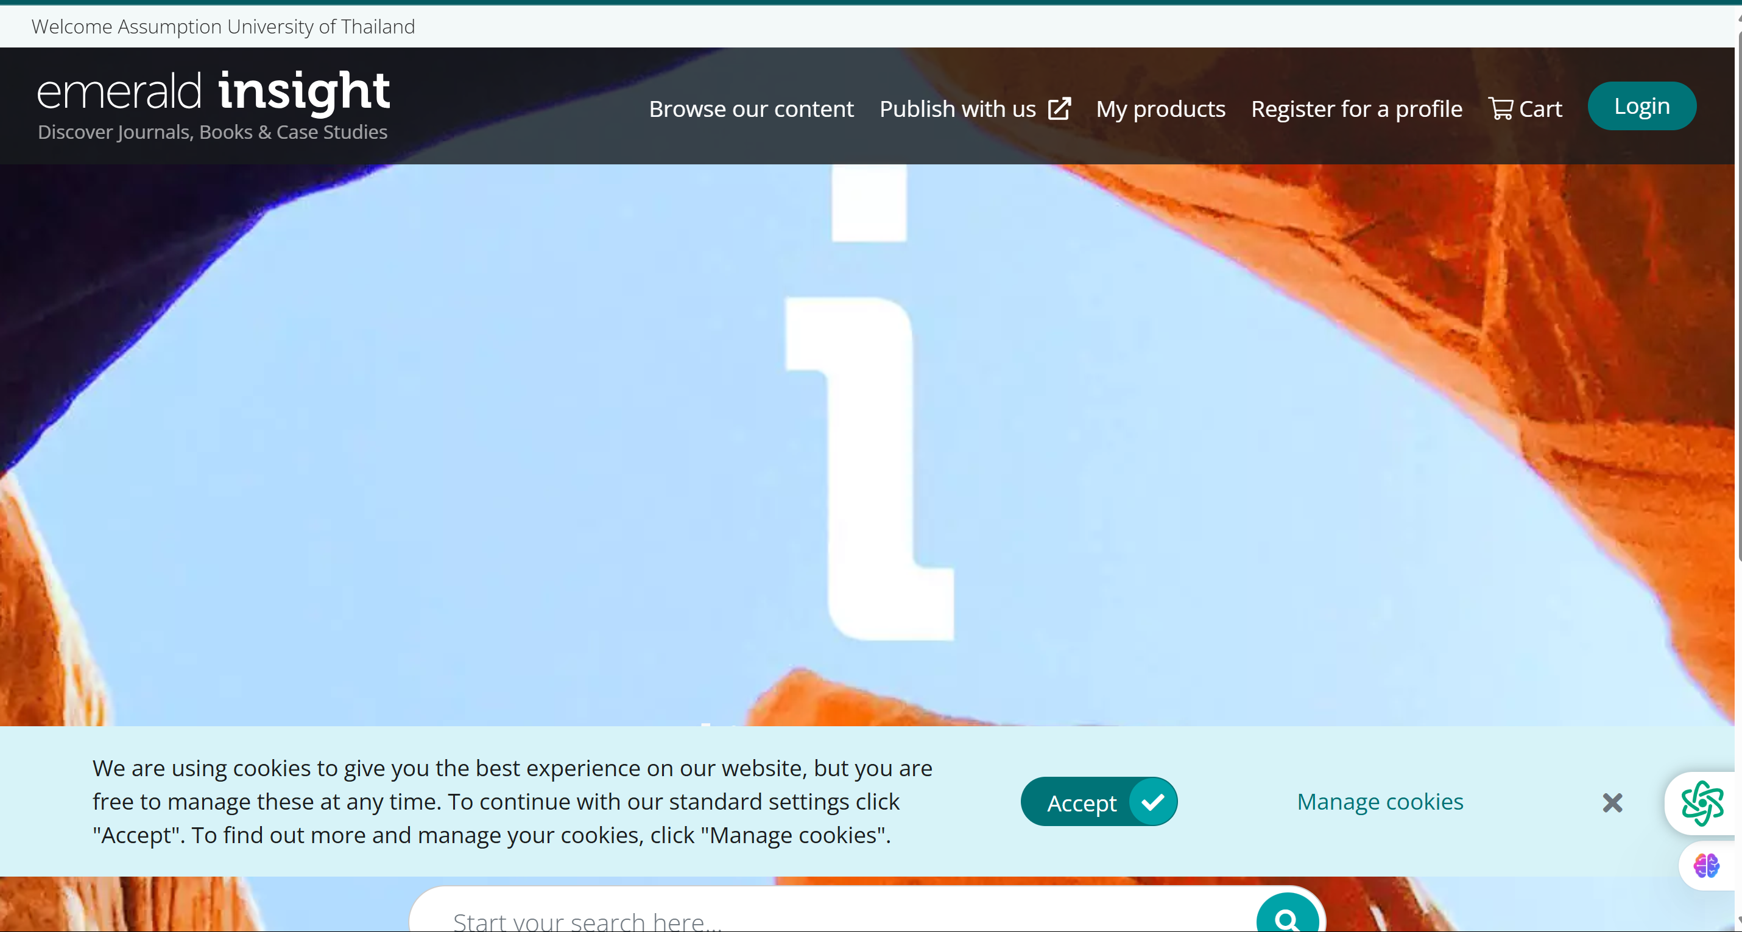
https://www.emerald.com/insight/

Slide 8
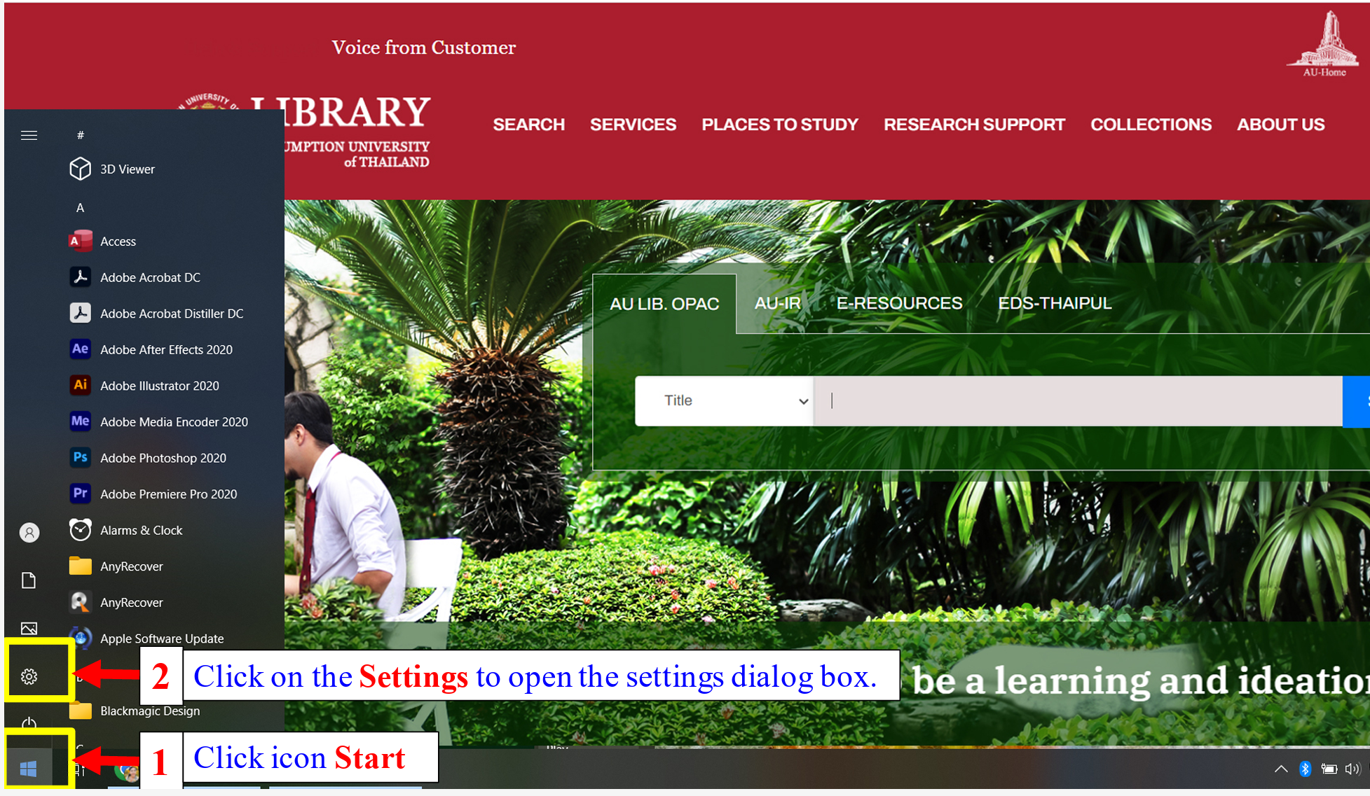

Slide 9
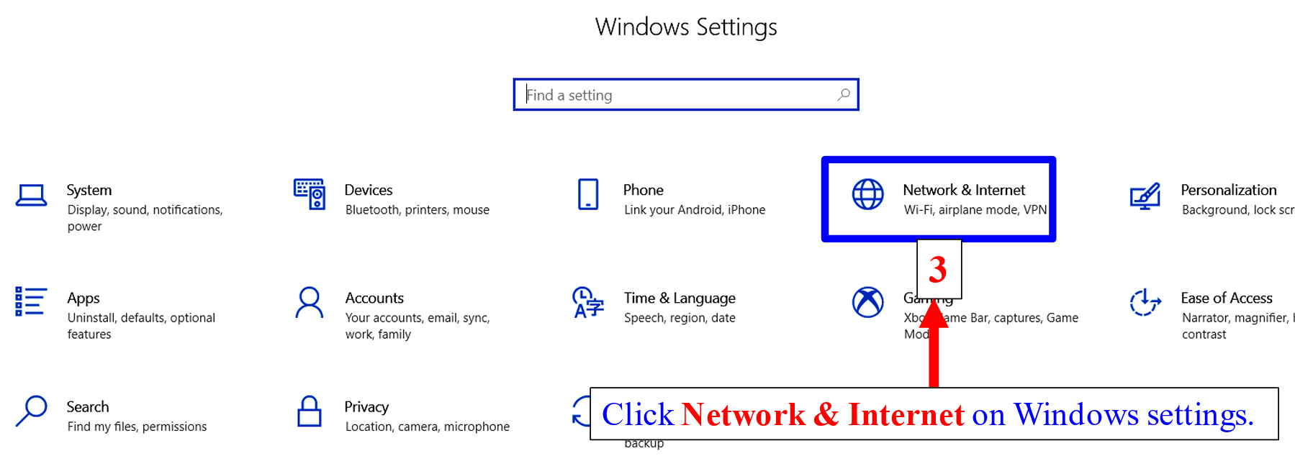

Slide 10
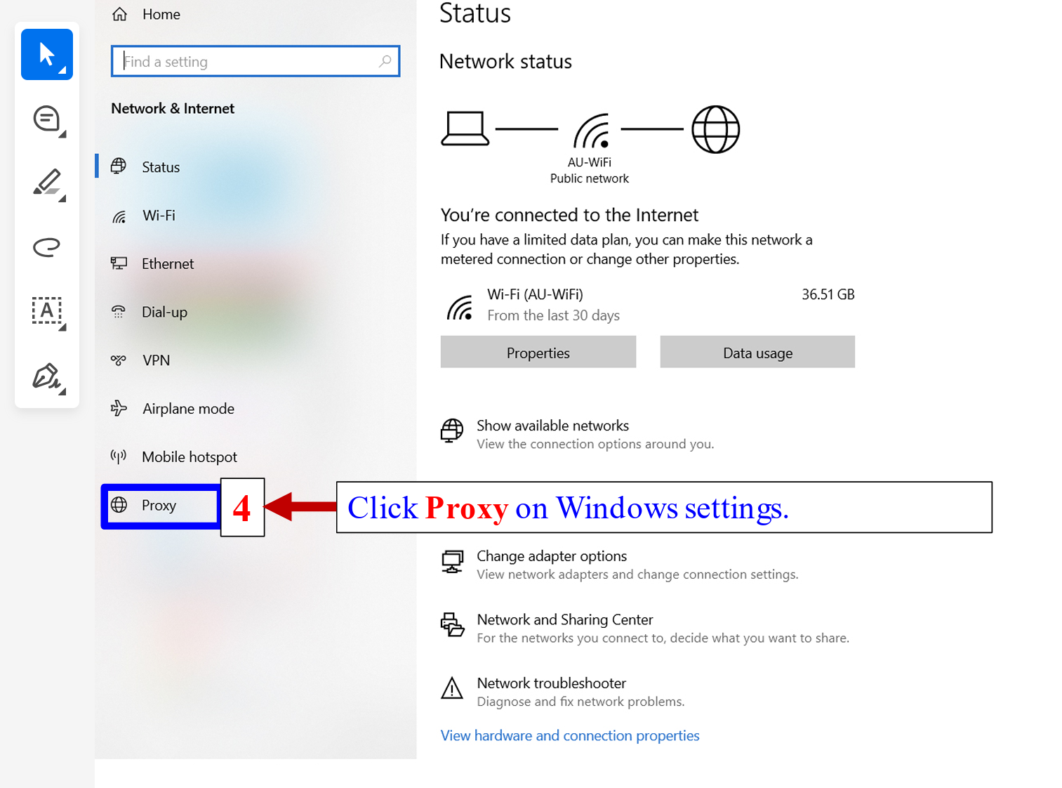

Slide 11
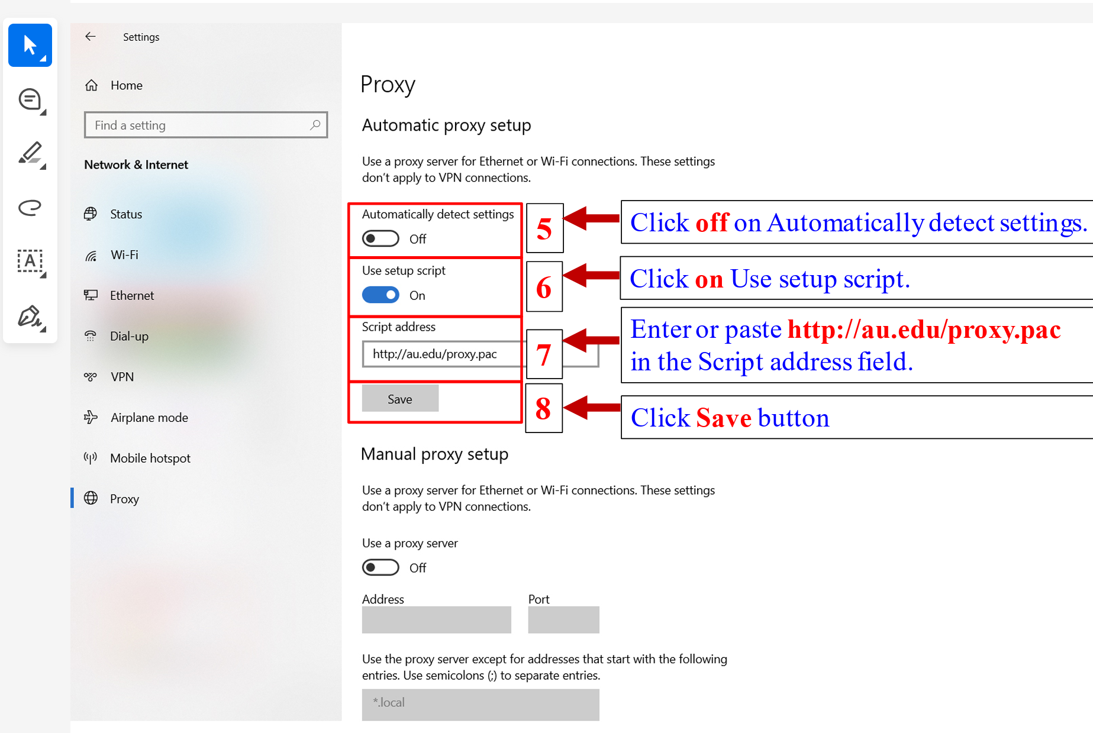

Slide 12
selecting individual research topics
Step 3: Define the Scope Clearly
Narrow your broad interests into specific areas (e.g., E-Commerce and Online Consumer Behavior; Information Security and Privacy).
A well-defined topic ensures clarity and manageability in your research project.

Slide 13
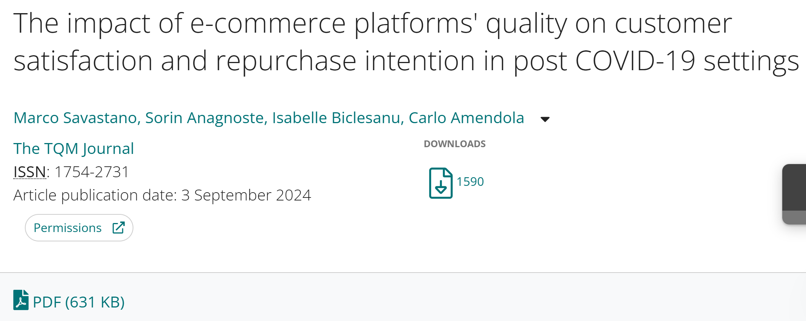
Step 3: Define the Scope Clearly

Slide 14
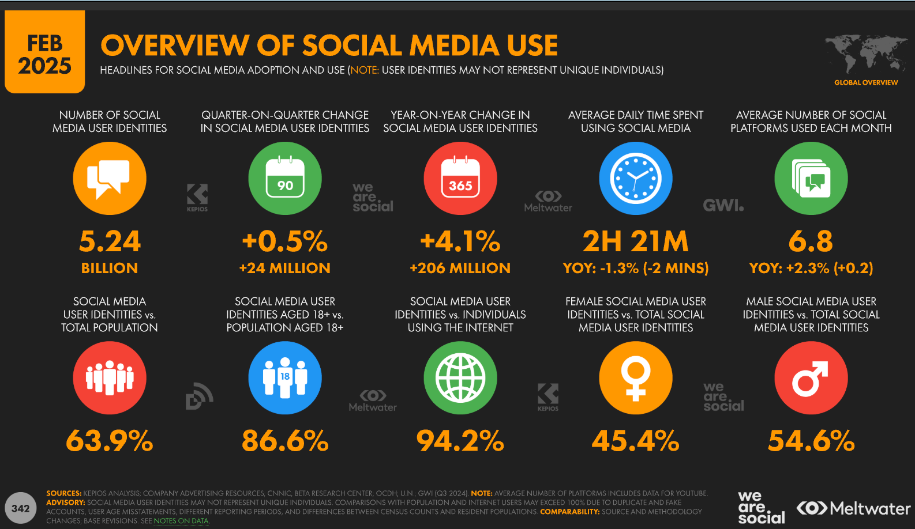
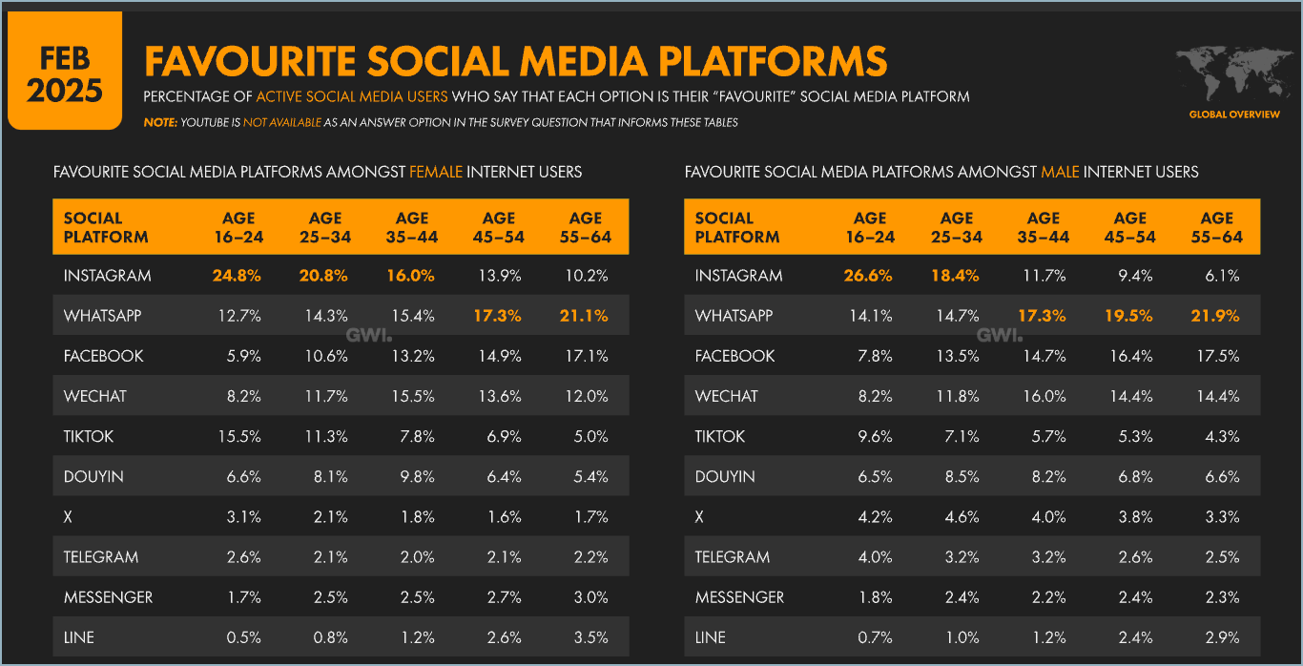
Step 3: Define the Scope Clearly
Source: https://www.smartinsights.com/social-media-marketing/social-media-strategy/new-global-social-media-research/

Slide 15
selecting individual research topics
Step 4: Apply a Relevant Theoretical Framework
Choose an established theoretical model, such as Stimulus-Organism-Response (SOR), Technology Acceptance Model (TAM), Unified Theory of Acceptance and Use of Technology (UTAUT), or Theory of Planned Behavior (TPB), to structure your research logically.
Ensure the framework suits your chosen topic, helping you identify clear independent variables (IVs) (at least three IVS) , dependent variables (DVs), and mediators or moderators if applicable.

Slide 16
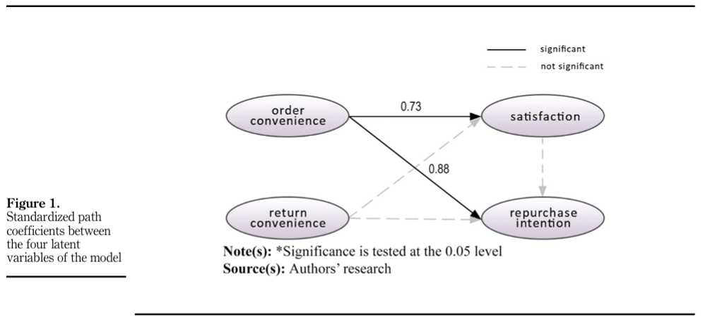
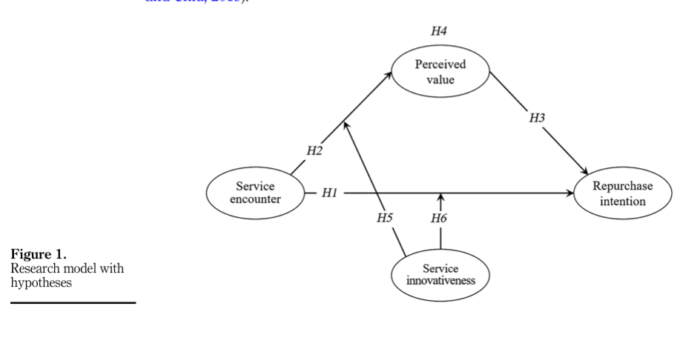
Theoretical Framework

Slide 17
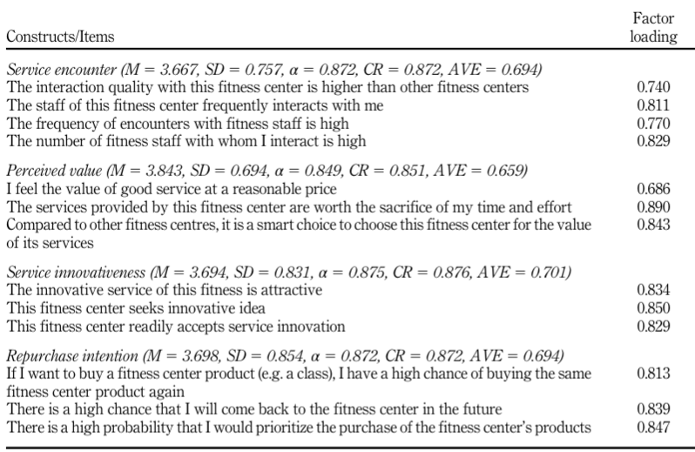
Variable measurement items

Slide 18
To build a conceptual framework
The conceptual framework will be based on our theoretical frameworks
These frameworks need to be :
In similar field
With the same dependent variables
Double check the definitions, are the same as in your research?
Let’s say, I want to study Repurchase Intention

Slide 19
Theoretical Framework1#

Slide 20
Theoretical Framework2#

Slide 21
conceptual framework
Order Convenience
H1
Repurchase Intention
H2
Perceive Value
H3
H6
H4
H5
Satisfaction
Service Encounter
We only can combine or link the variables with the linkage from the theoretical framework.

Slide 22
Research hypothesis
Order Convenience → Repurchase Intention
Order Convenience → Satisfaction
Perceive Value → Repurchase Intention
Service Encounter → Perceive Value
Service Encounter → Repurchase Intention
Satisfaction→ Repurchase Intention

Slide 23
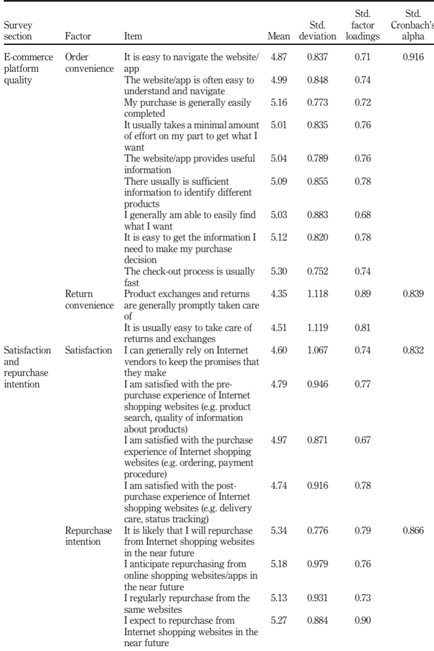
MEASUREMENT ITEMS

Slide 24
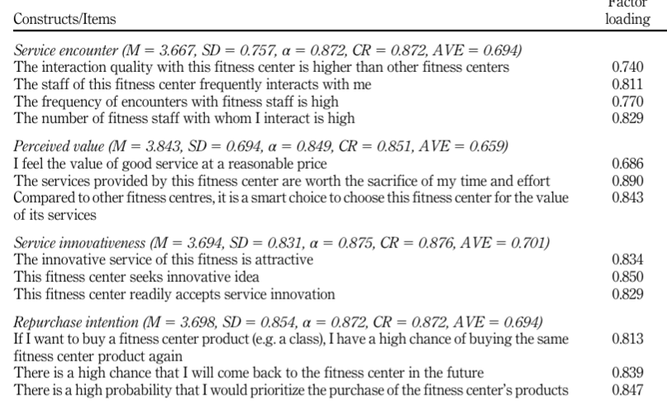
MEASUREMENT ITEMS

Slide 25
Chapters of the research
Chapter 1: introduction
1.1 Background of Study
1.2 Statement of problem
1.3 Research Objectives
1.4 Research Questions
1.5 Scope of Research
1.6 Research Limitations
1.7 Significance of the Study
1.8 Definition of Terms
Chapter 2 : Literature review
2.1 Theories Related to Each Variable
2.2 Related Review Literature
Definition of each variable
Relationship between variables
2.3 Previous Studies

Slide 26
Chapters of the research
Chapter 3 Research framework
3.1 Theoretical frameworks
3.2 Conceptual framework
3.3 Research Hypotheses
3.4 Operationalization table
Chapter 4 Research methodology
4.1 Research design
4.2 Sampling procedure
4.3 Research Instrument/ Questionnaire Design
4.4 Data Collection
4.5 Statistical Treatment of Data

Slide 27
Chapters of the research
Chapter 5 Research result
5.1 Reliability testing
5.2 Descriptive analysis
5.3 Mean and Standard Deviation for Descriptive Analysis
5.4 Hypothesis Testing Results
Chapter 6 Discussion and recommendation
6.1 Discussion and conclusion
6.2 Recommendations based on Finding
6.3 Future studies
References

Slide 28
Assignment 1#
Research title: “Factors impact on DV: The Mediating Role of mediator factor Among target audience in location"
Target population
Theoretical frameworks (at least 2)
Conceptual framework (build based on theoretical framework)
Variables: at least three IVs, one DV, better to have a mediator
And the measurement scale item based on your variables (borrow from pervious researches)
Submit before next Monday.

Slide 29
Thank you
Faculty member of ITM
guqizhen@au.edu

Slide 30
Guest speaker Prof.Dr.lars
Wed,4 June 2025
AI BASED TECHNOLOGY AND SMART MARKETING
A72 HUAMAK CAMPUS, 10:00-11:45

